Slide 1
Project 6: River Observed Baseflow
Supratik Chanda And Justin FairBourn

Slide 2
River Segment Dataset
Each row of the dataset corresponds to one measure of a river segment during one month with the following columns:
Date
Segment ID
X/Y (spatial location)
Evapotranspiration (surrounding area water loss through natural means)
Precipitation
Irrigation Pumping (surrounding area water loss through manmade means
Observed Baseflow (measure of water amount moved by river)

Slide 3
Techniques
Data Cleanup and Validation
Data Separation (by Segment ID)
Linear Regression
Multiple Linear Regression
Scatterplots (with/without regression lines)
Data Aggregation

Slide 4
Initial Questions
Which factors affect baseflow significantly?
Do certain factors affect certain segments differently? If so, which factors and which segments?
Can we predict the baseflow of a river segment given only another attribute or combination of attributes?

Slide 5
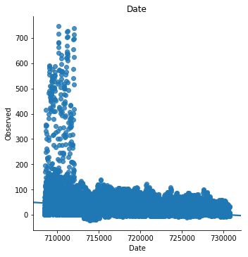
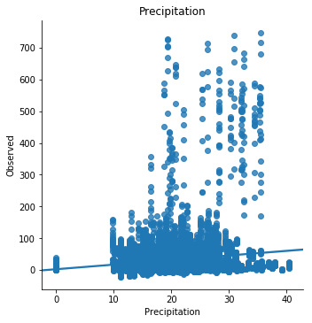
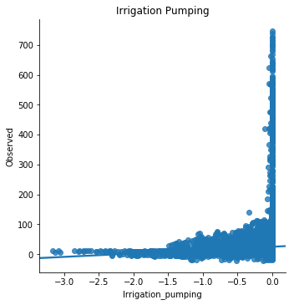
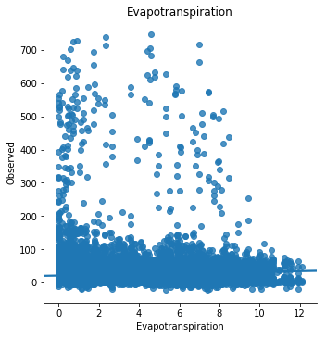
The Process I
Our process started with looking for overall trends in the whole dataset.
Quickly decided to examine on a segment-by-segment basis.

Slide 6
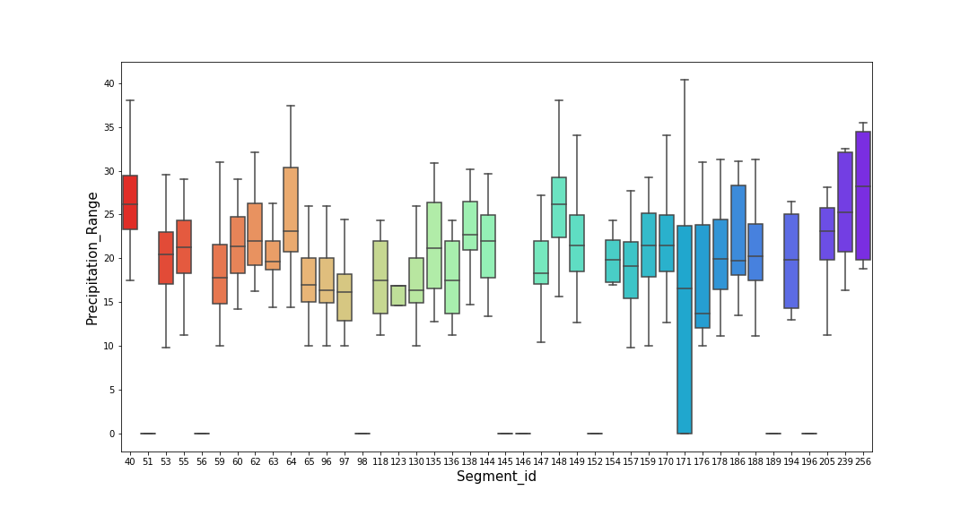
The Process II
Spread of Precipitation and Evapotranspiration across different segment ids:

Slide 7
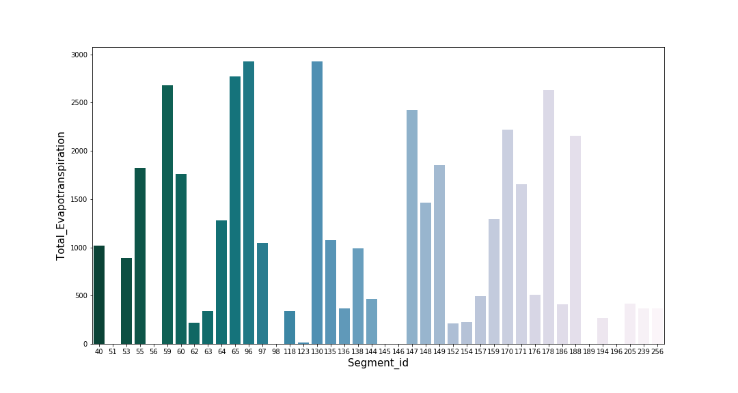
The Process II.5

Slide 8
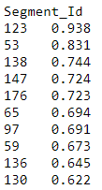
The Process III
Performed Linear Regression using statsmodels and found the segments with the highest R-Squared values:

Slide 9

The Process IV: How can accuracy of the model be improved hacking p-value!
Before:
After:

Slide 10
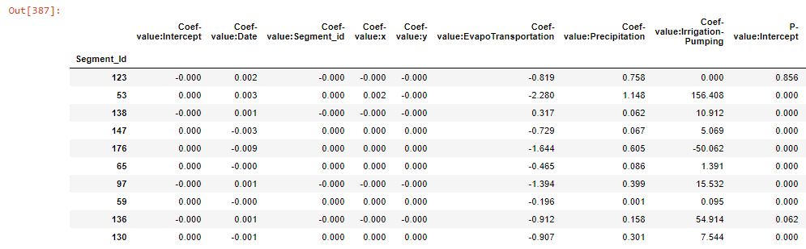
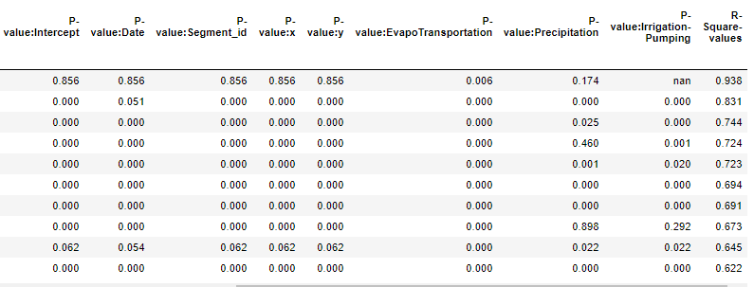
The inside Story!

Slide 11
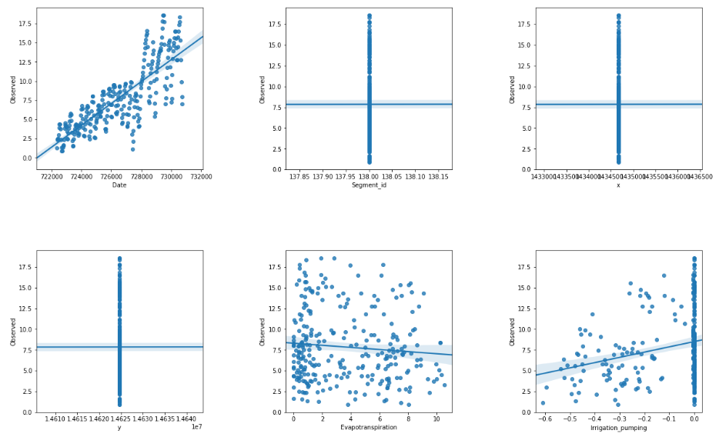
One example of a Segment ID’(138) coefficient-Value display.

Slide 12
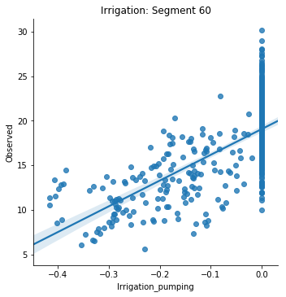
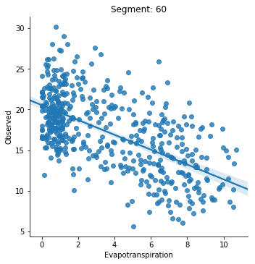
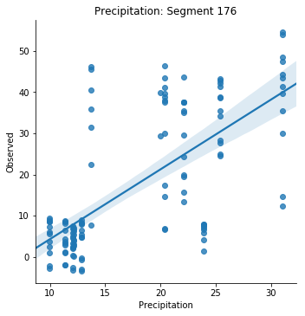
The Process IV
Also filtered and examined segment id/feature combinations based on certain p-value, coefficient, and R-Squared values (0.05, +/-0.1, and 0.33)

Slide 13
TODO: Conclusion Slide
1) Null hypothesis is inferred using the p-values significance
2) Best fit models are concluded according to their p-values
3)Coefficient-values displays whether the dependent variables will increase or decrease on increase of Observed

Slide 14
Questions?

